Slide 1
React.js Part 2: Router and Redux
By Dzmitry Belaichuk
June 2019

Slide 2
Agenda
1
SPA and client-side routing
2
React Router v.4
3
MVC. Flux. Redux
4
React-Redux
5
Advanced

Slide 3
SPA and client-side routing

Slide 4
Single page application
A single-page application (SPA) is a website that re-renders its content in response to navigation actions (e.g. clicking a link) without making a request to the server to fetch new HTML.
CONFIDENTIAL | © 2019 EPAM Systems, Inc.

Slide 5
Single page application
A single-page application (SPA) is a website that re-renders its content in response to navigation actions (e.g. clicking a link) without making a request to the server to fetch new HTML.
Single-page applications can use state from:
Internal state
CONFIDENTIAL | © 2019 EPAM Systems, Inc.

Slide 6
Single page application
A single-page application (SPA) is a website that re-renders its content in response to navigation actions (e.g. clicking a link) without making a request to the server to fetch new HTML.
Single-page applications can use state from:
Internal state.
BUT! Internal state SPAs are limited because there is only one “entry”.
A single entry means that you always start at the root when you enter the application.
When you navigate within an internal-state app, there is no external representation.
If you want to share some content, the other person loading the app will start at the root, so you’ll have to explain how to get to desired content.
CONFIDENTIAL | © 2019 EPAM Systems, Inc.

Slide 7
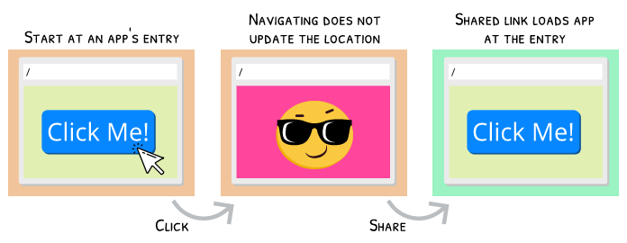
Single page application
A single-page application (SPA) is a website that re-renders its content in response to navigation actions (e.g. clicking a link) without making a request to the server to fetch new HTML.
Single-page applications can use state from:
Internal state
CONFIDENTIAL | © 2019 EPAM Systems, Inc.

Slide 8
Single page application
A single-page application (SPA) is a website that re-renders its content in response to navigation actions (e.g. clicking a link) without making a request to the server to fetch new HTML.
Single-page applications can use state from:
Internal state
External state (location-based)
With location-based SPAs, you can share a link and be confident that anyone opening that link will see the same thing as you because the location is always updating as you navigate.
CONFIDENTIAL | © 2019 EPAM Systems, Inc.

Slide 9
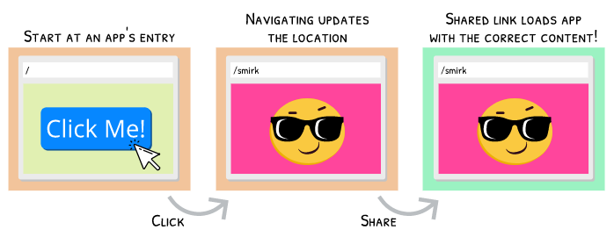
Single page application
A single-page application (SPA) is a website that re-renders its content in response to navigation actions (e.g. clicking a link) without making a request to the server to fetch new HTML.
Single-page applications can use state from:
Internal state
External state (location-based)
CONFIDENTIAL | © 2019 EPAM Systems, Inc.

Slide 10
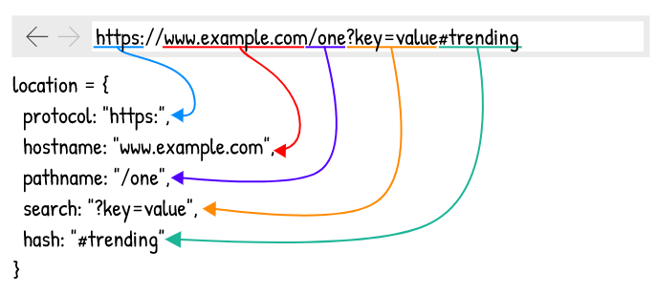
URL
Object window.location
CONFIDENTIAL | © 2019 EPAM Systems, Inc.

Slide 11
Change URL without page reloading
The point of a single-page application is to avoid requests hitting the server (during navigation)*.
* - it is ok to load a new piece data from server for a new route (via AJAX) BUT we need to avoid to load HTML/CSS/JS content during navigation
CONFIDENTIAL | © 2019 EPAM Systems, Inc.

Slide 12
Change URL without page reloading
The point of a single-page application is to avoid requests hitting the server (during navigation)*.
How to control URL without page reloading:
Change only hash fragment (old-fashion)
Use History API (HTML5) - https://developer.mozilla.org/en-US/docs/Web/API/History_API
CONFIDENTIAL | © 2019 EPAM Systems, Inc.

Slide 13
React Router v.4

Slide 14
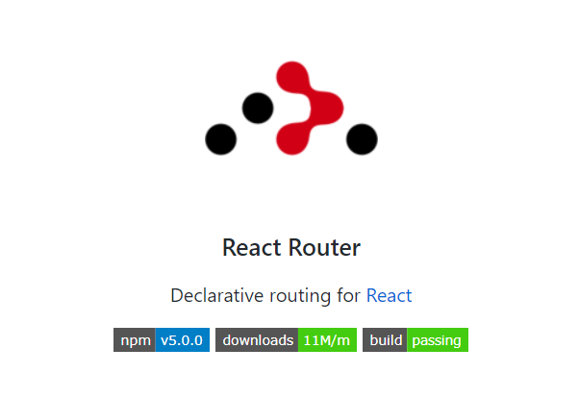
React Router library
https://github.com/ReactTraining/react-router
https://reacttraining.com/react-router/web/guides/quick-start
CONFIDENTIAL | © 2019 EPAM Systems, Inc.

Slide 15
Basic components
There are three types of components in React Router:
router components
route matching components
navigation components
CONFIDENTIAL | © 2019 EPAM Systems, Inc.

Slide 16
Basic components
Typically apps will use one of the high-level routers instead (different history object):
<BrowserRouter>
<HashRouter>
<MemoryRouter>
<NativeRouter>
<StaticRouter>
CONFIDENTIAL | © 2019 EPAM Systems, Inc.

Slide 17
<HashRouter> example 01.hashRouter
import * as React from 'react';
import * as ReactDom from 'react-dom';
import { HashRouter as Router, Route, Link } from 'react-router-dom';
Import Posts from '../Posts'
// const Posts = () => <p>Posts</p>;
// const About = () => <p>About</p>;
export class App extends React.Component {
render() {
return (
<Router>
<Route path="/posts" component={Posts} />
<Route path="/about" component={About} />
</Router>
);
}
}
CONFIDENTIAL | © 2019 EPAM Systems, Inc.

Slide 18
<BrowserRouter> example 02.browserRouter
import * as React from 'react';
import * as ReactDom from 'react-dom';
import { BrowserRouter as Router, Route, Link } from 'react-router-dom';
const Posts = () => <p>Posts</p>;
const About = () => <p>About</p>;
export class App extends React.Component {
render() {
return (
<Router>
<Route path="/posts" component={Posts} />
<Route path="/about" component={About} />
</Router>
);
}
}
CONFIDENTIAL | © 2019 EPAM Systems, Inc.

Slide 19
404 page 03.not_found
const Posts = () => <p>Posts</p>;
const About = () => <p>About</p>;
const NotFound = () => <p>404 Not Found</p>;
export class App extends React.Component {
render() {
return (
<Router>
<Switch>
<Route path="/posts" default component={Posts} />
<Route path="/about" component={About} />
<Route component={NotFound} />
<Switch>
</Router>
);
}
}
CONFIDENTIAL | © 2019 EPAM Systems, Inc.

Slide 20
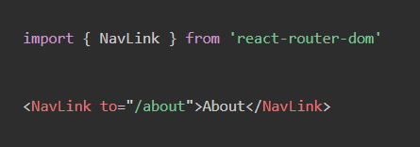
Styling active routes 04.link_styling
<NavLink> - special version of <Link>
It adds styling attributes to the rendered element when it matches the current URL
CONFIDENTIAL | © 2019 EPAM Systems, Inc.

Slide 21
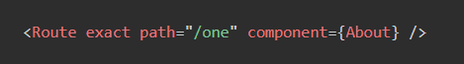
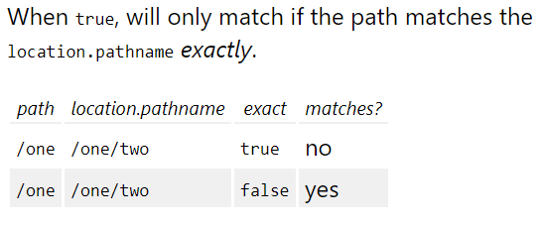
Home link 05.home_link
/ - start symbol of each route
exact prop of <Route> helps us!
CONFIDENTIAL | © 2019 EPAM Systems, Inc.

Slide 22
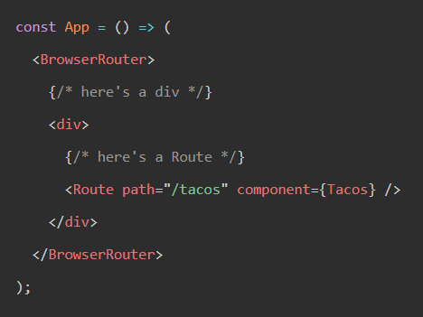
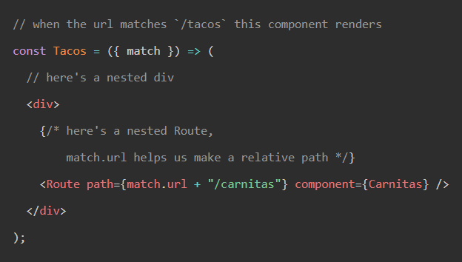
Nested routes 06.nested_routes
<Route> is just a component like <div>
CONFIDENTIAL | © 2019 EPAM Systems, Inc.

Slide 23
Path prop of <Route> 07.params
Prop path: string | string[]
<Route path="/about/:tab/:section" component={Posts} />
Routes without a path always match.
Valid string for path should correspond https://github.com/pillarjs/path-to-regexp/tree/v1.7.0
CONFIDENTIAL | © 2019 EPAM Systems, Inc.

Slide 24
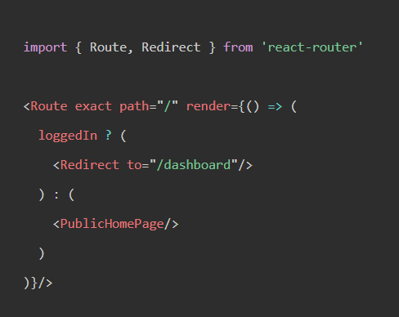
<Redirect> 08.redirect
<Redirect> component will navigate to a new location
CONFIDENTIAL | © 2019 EPAM Systems, Inc.

Slide 25
MVC. flux. Redux

Slide 26
Let’s start from the beginning… a little bit of history
MVC
FLUX
REDUX

Slide 27
mvc

Slide 28
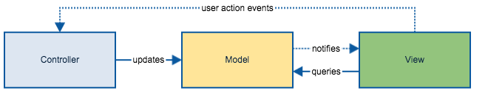
MVC: one view

Slide 29
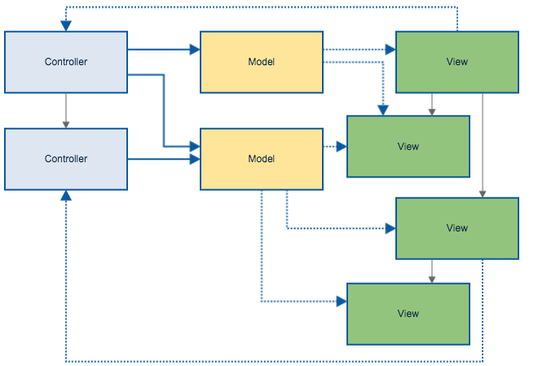
MVC: multiple views

Slide 30
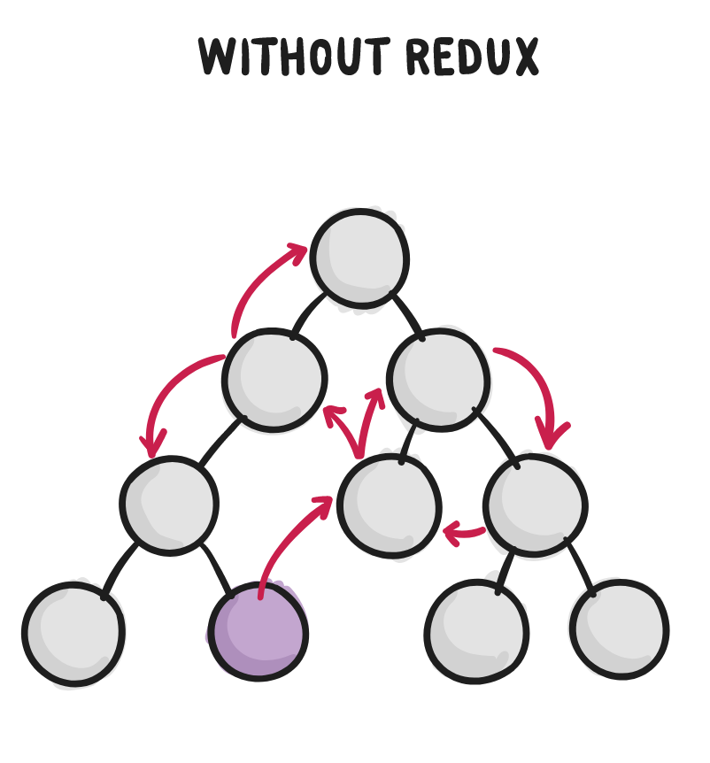
MVC: much more views

Slide 31
flUX

Slide 32
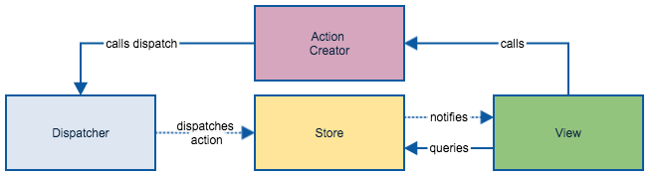

With Flux: one view

Slide 33
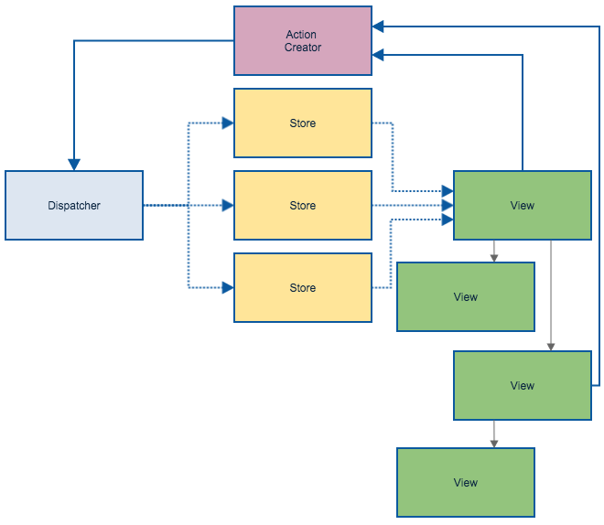
Flux: multiple views

Slide 34
REDUX

Slide 35
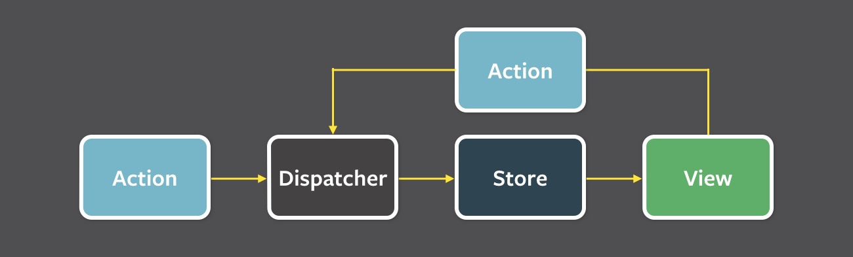
Redux: one view

Slide 36
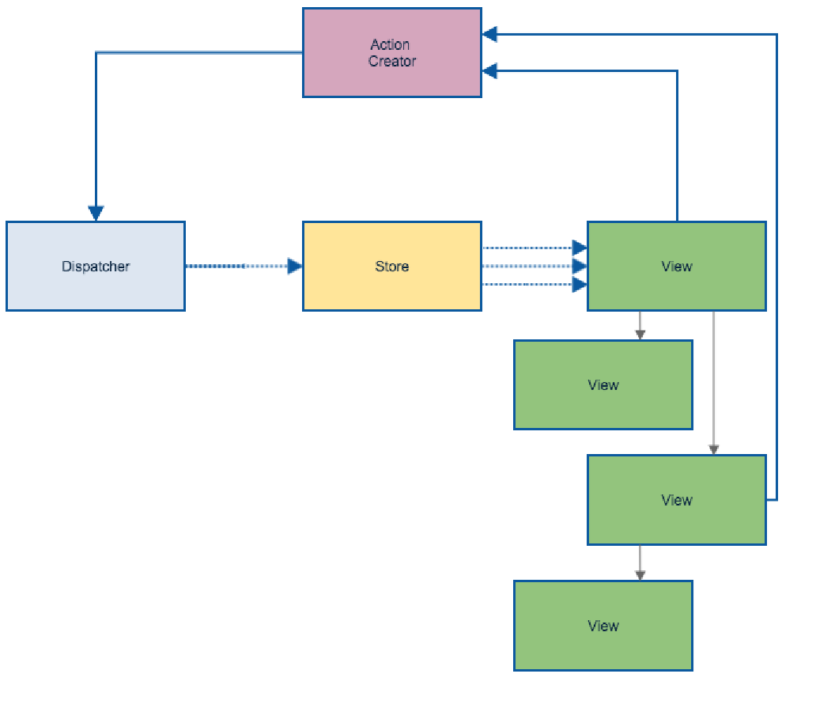

Redux: multiple views

Slide 37
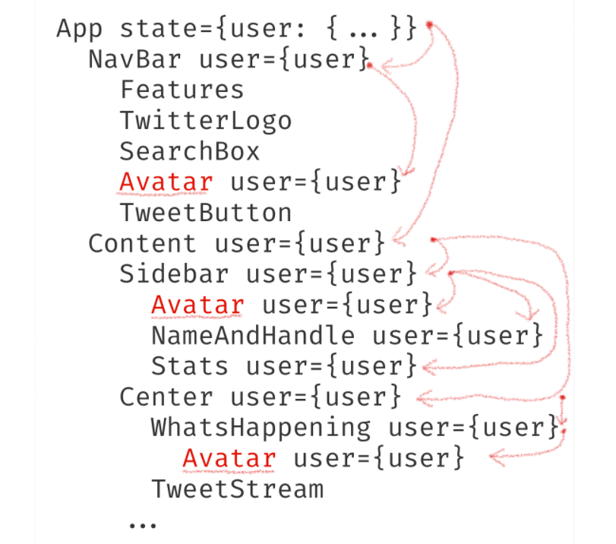
React: props drilling

Slide 38
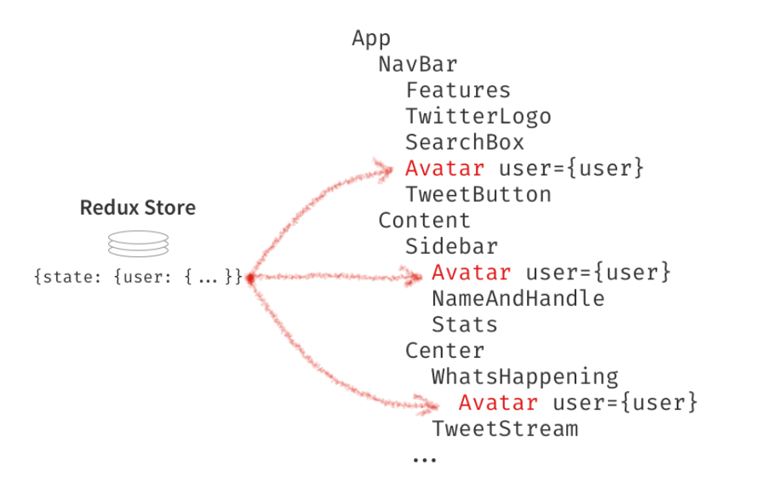
React with Redux

Slide 39

Redux in details
Store
Action
Reducer
View

Slide 40
Redux: store
A store holds the whole state tree of your application.
The only way to change the state inside it is to dispatch an action on it
A store is not a class. It's just an object
To create a store, pass your root reducing function to createStore

Slide 41
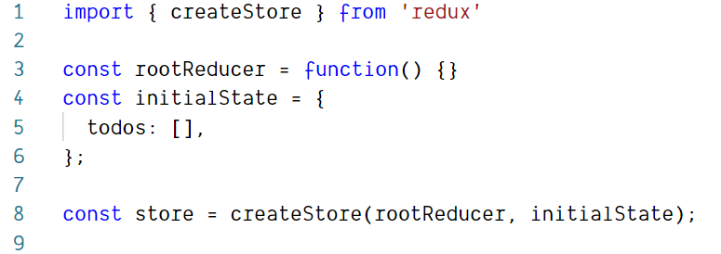
Redux: store creation

Slide 42
Redux: action
Payloads of information that send data from your application to your store
They are the only source of information for the store
You send them to the store using store.dispatch()

Slide 43
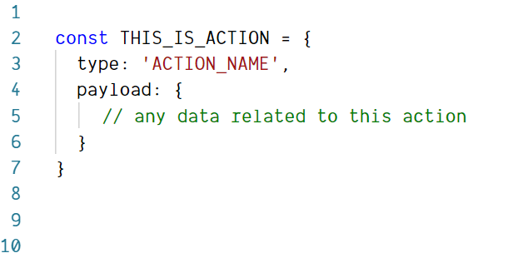
Redux: action example

Slide 44
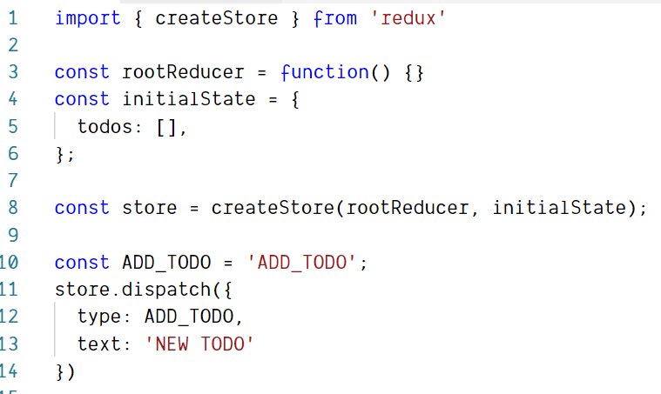
Redux: action example

Slide 45
Redux: action creator
Action creators are exactly that—functions that create actions.

Slide 46
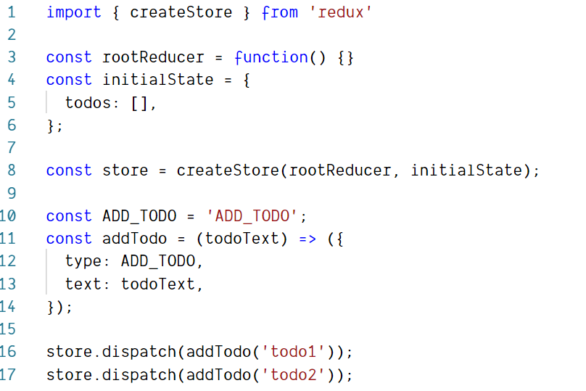
Redux: action creator example

Slide 47
Redux: reducer
Specify how the application's state changes in response to actions sent to the store
Given the same arguments, it should calculate the next state and return it.

Slide 48
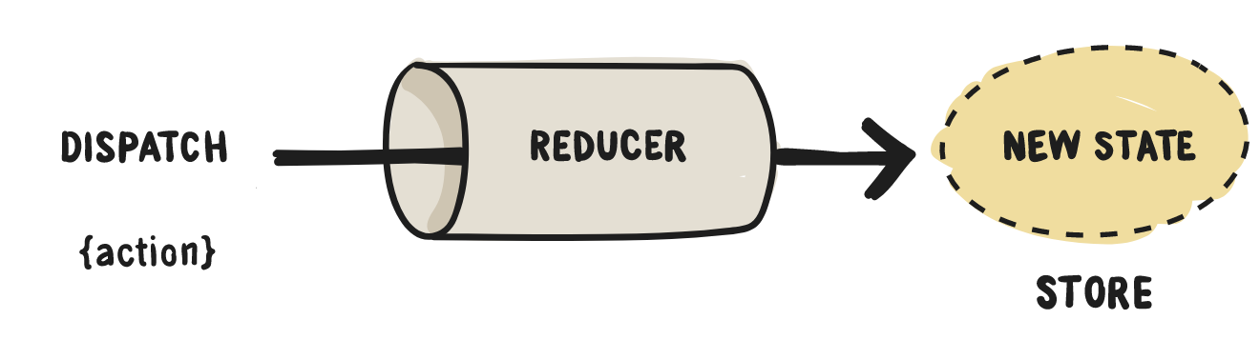
Redux: reducer

Slide 49
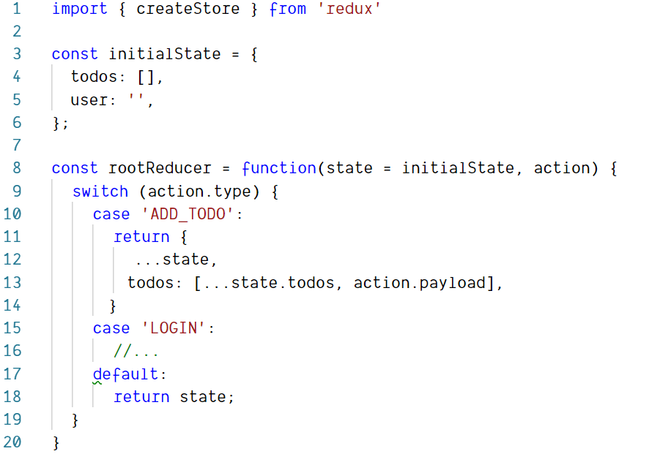
Redux: reducer example

Slide 50
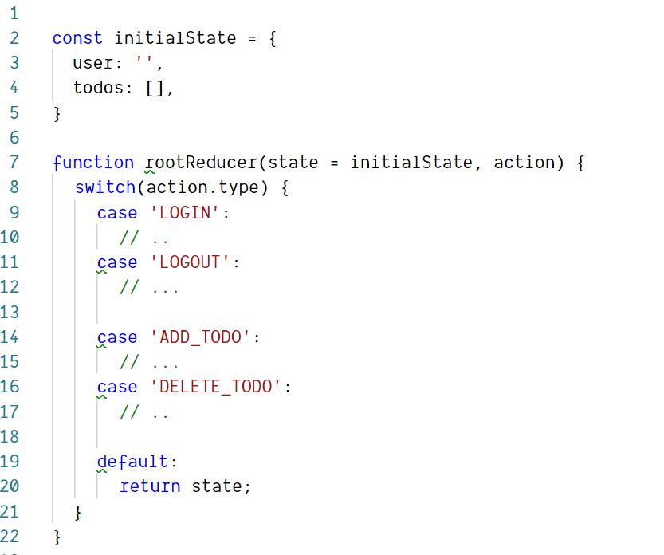
Redux: splitting reducers

Slide 51
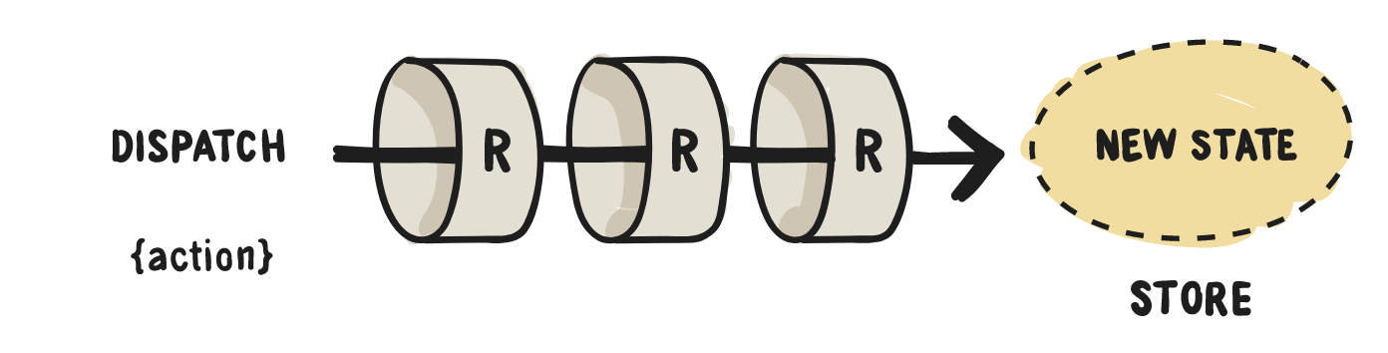
Redux: splitting reducers

Slide 52
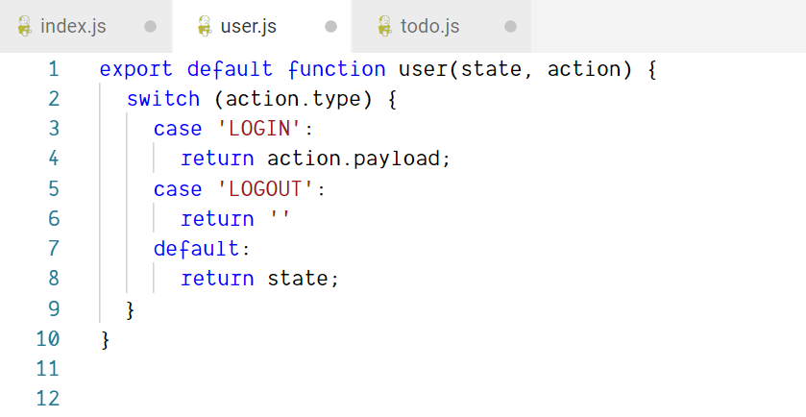
Redux: splitting reducers

Slide 53
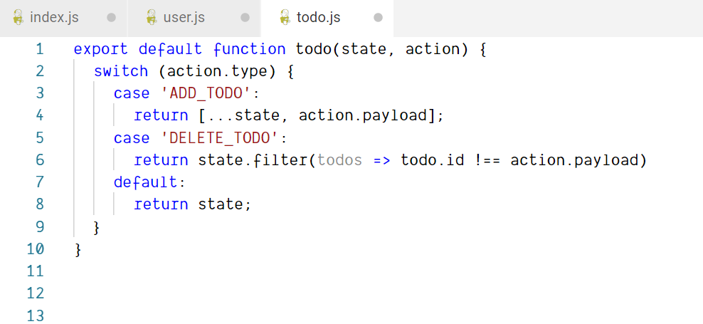
Redux: splitting reducers

Slide 54
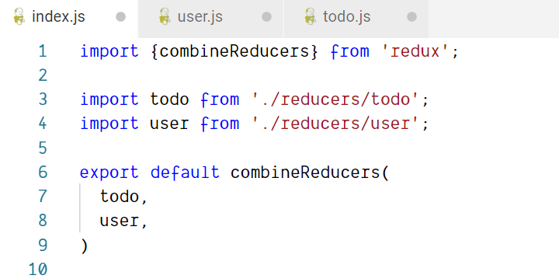
Redux: splitting reducers

Slide 55
Redux: three principles
Single source of truth
State is read-only
Changes are made with pure functions

Slide 56
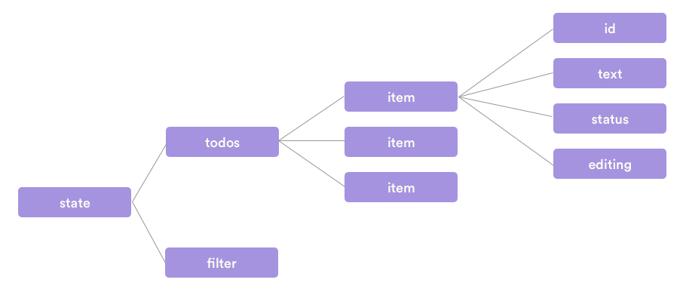
Redux: single source of truth principle
The state of your whole application is stored in an object tree within a single store.

Slide 57

Redux: state is read-only principle
The only way to change the state is to emit an action, an object describing what happened.
This ensures that neither the views nor the network callbacks will ever write directly to the state

Slide 58
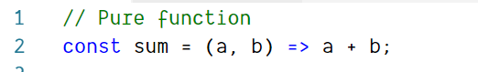
Pure functions
Its return value is the same for the same arguments
Its evaluation has no side effects (no mutation of local static variables, non-local variables, mutable reference arguments or I/O streams).

Slide 59
Redux: changes are made with pure functions principle
To specify how the state tree is transformed by actions, you write pure reducers.
Remember to return new state objects, instead of mutating the previous state

Slide 60
React-redux

Slide 61
react-redux
React Redux is the official React binding for Redux. It lets your React components read data from a Redux store, and dispatch actions to the store to update data.

Slide 62
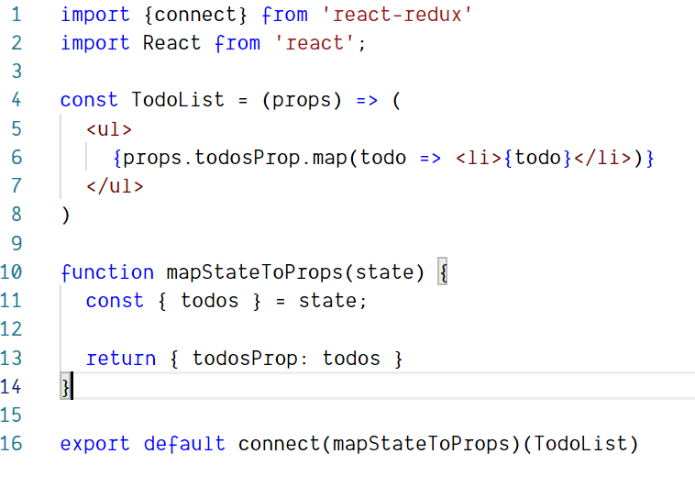
react-redux API: connect props

Slide 63
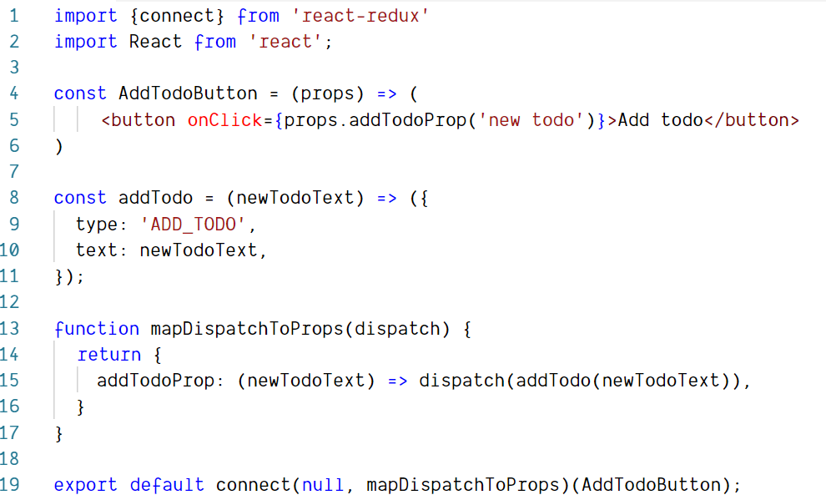
react-redux API: connect actions

Slide 64
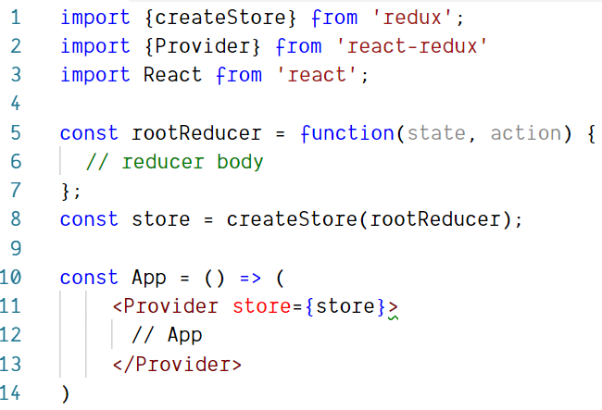
react-redux API: Provider

Slide 65
Redux: asynchronous actions
Redux-thunk
Redux-saga
Redux-observable

Slide 66
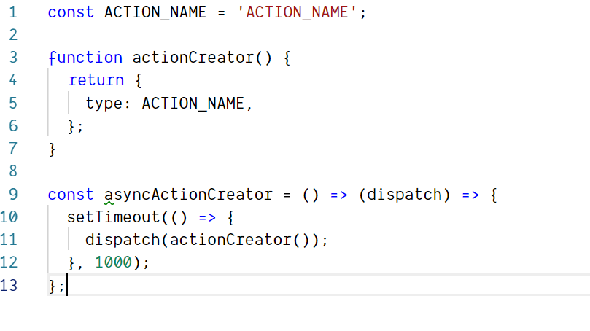
Redux-thunk: simple solution

Slide 67
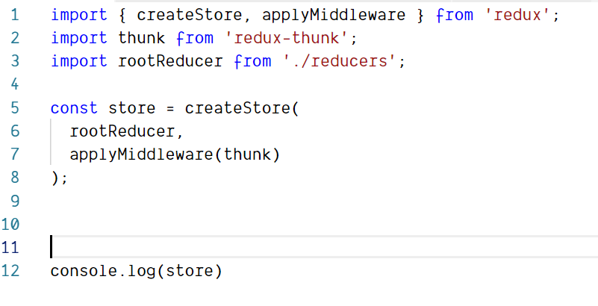
Redux-thunk: installation

Slide 68
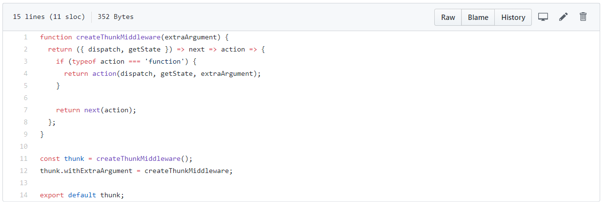
Redux-thunk: source code

Slide 69
advanced

Slide 70
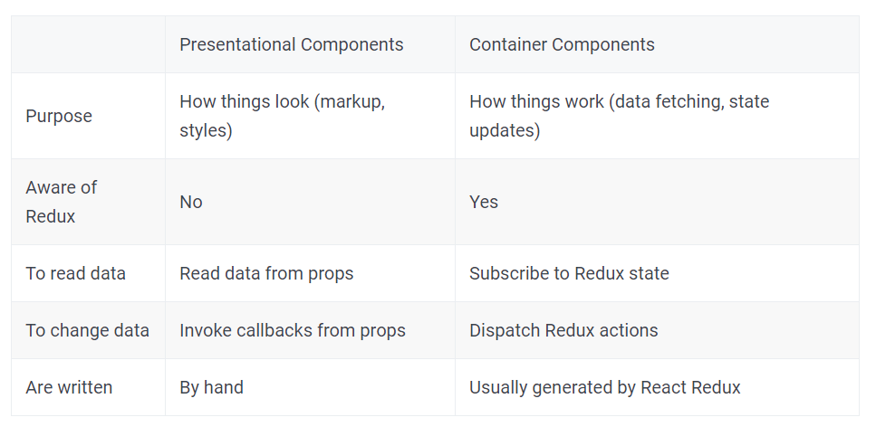
Conventions: presentational and container components

Slide 71
Conventions: flux standard action
Set of rules for defining the flux action object

Slide 72
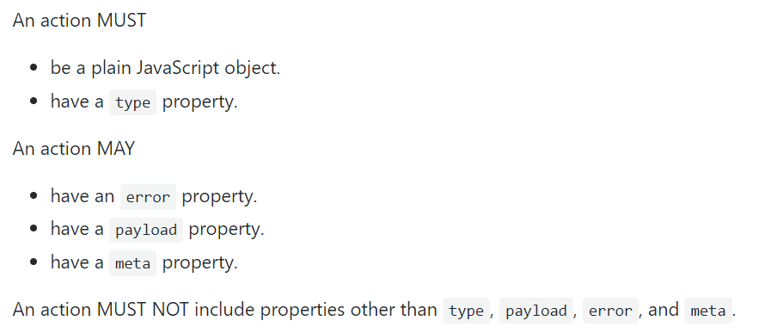
Conventions: flux standard action

Slide 73
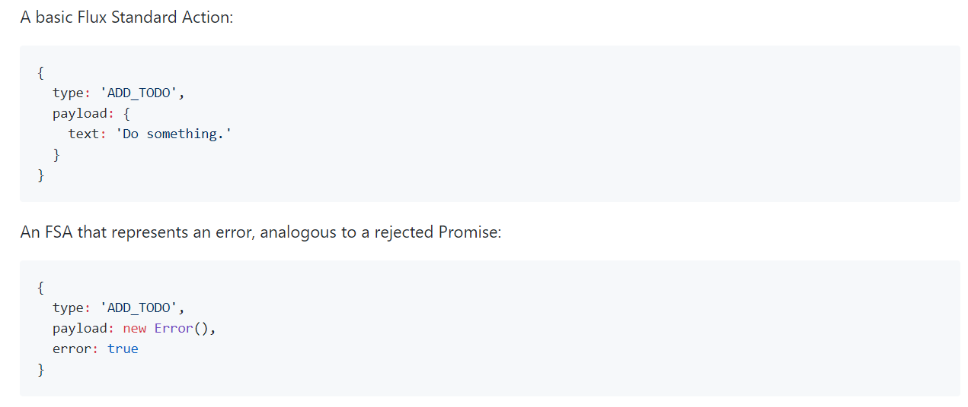
Conventions: flux standard action example

Slide 74
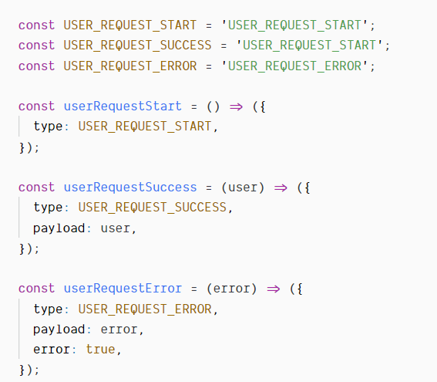
Reducing boilerplate: the problem

Slide 75

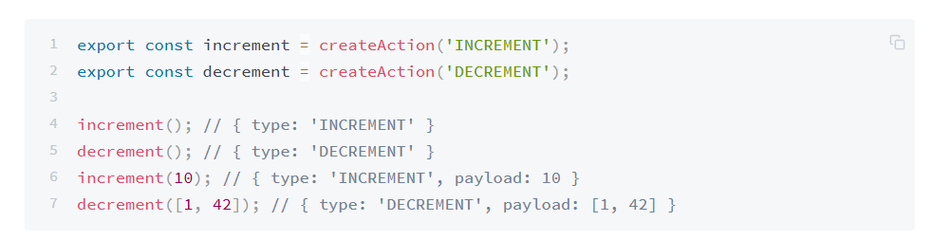
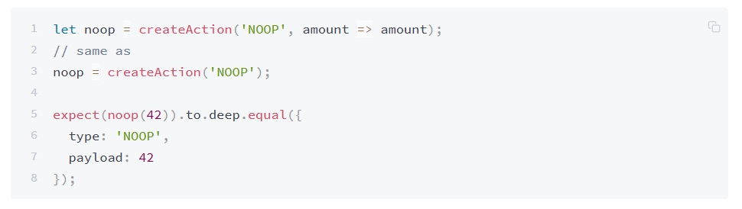
Reducing boilerplate:

Slide 76
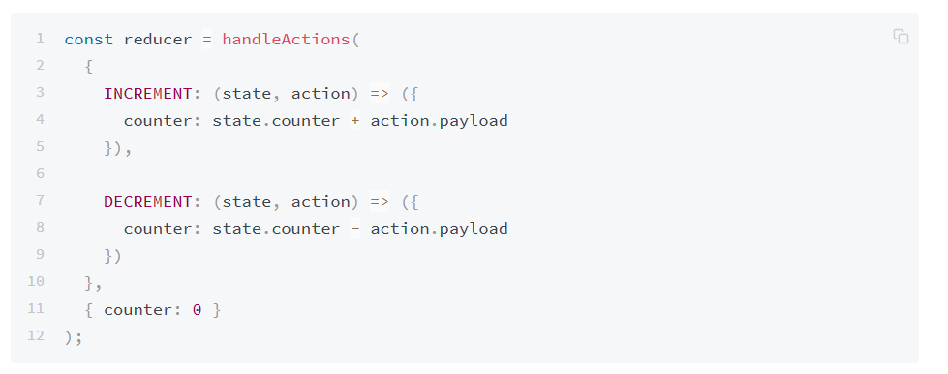
Reducing boilerplate: reducers

Slide 77
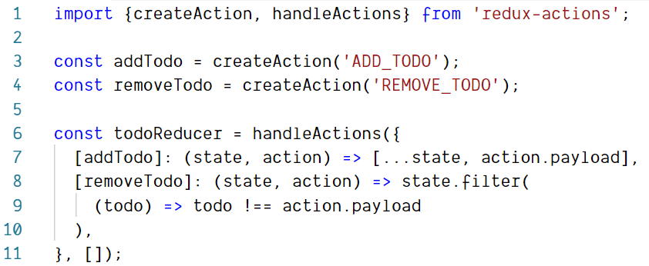
Reducing boilerplate: reducers

Slide 78
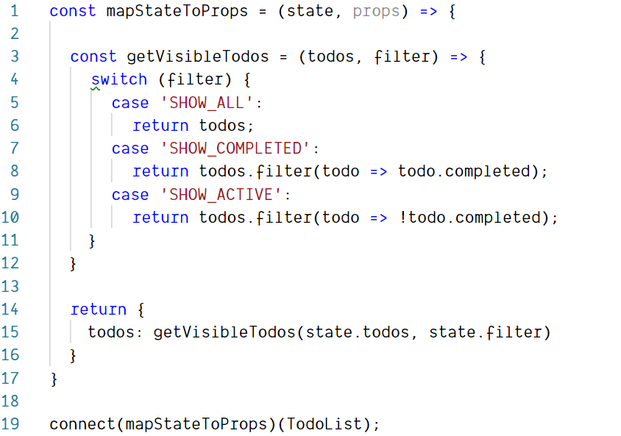
Computing derived data

Slide 79
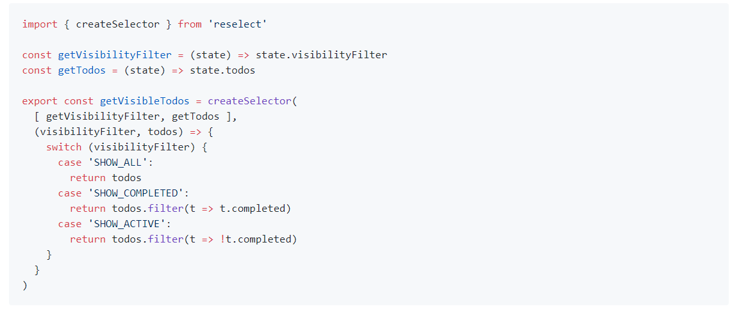
Computing derived data optimization: reselect

Slide 80
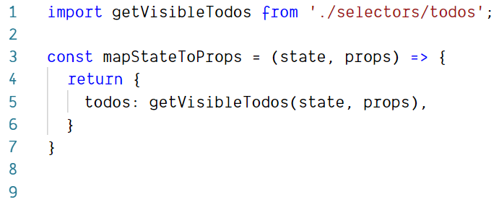
Computing derived data optimization: reselect

Slide 81
Q&A

Slide 82
THANK you!

